Slide 1
Stackable Instructionally-embedded Portable Science (SIPS) Assessments
Grade 5 Unit 1
Matter and Its Interactions
Storyline Overview
May 2023
The Grade 5 Unit 1 Matter and Its Interactions: Storyline Overview was developed with funding from the U.S. Department of Education under the Competitive Grants for State Assessments Program, CFDA 84.368A. The contents of this guide do not represent the policy of the U.S. Department of Education, and no assumption of endorsement by the Federal government should be made.
All rights reserved. Any or all portions of this document may be reproduced and distributed without prior permission, provided the source is cited as: Stackable Instructionally-embedded Portable Science (SIPS) Assessments Project. (2023). Grade 5 Unit 1 Matter and Its Interactions: Storyline Overview. Lincoln, NE: Nebraska Department of Education.

Slide 2
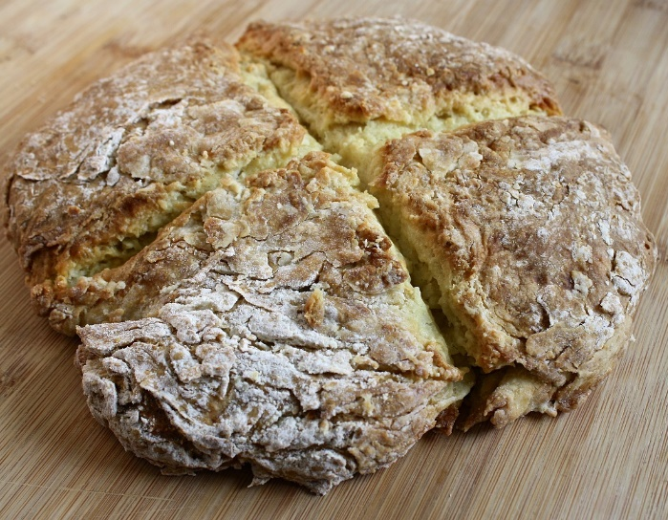
Grade 5 Unit 1: Storyline, Phenomena, and Segments
Storyline Overview
Students make sense of the key disciplinary ideas of matter and its properties, physical and chemical changes, and that the properties of matter can be investigated and used to describe substances, including the conservation of mass during changes.
Anchor Phenomenon
Measurement Target
Students are able to apply Science and Engineering Practices with emphasis on developing and using models and planning and carrying out investigations including evaluating evidence using mathematics and computational thinking related to the scale of the structure and properties of matter, including whether or not matter is conserved, and to identify materials and mixtures based upon their properties or results of a reaction before and after mixing.
The anchor phenomenon uses a scenario involving baking soda bread, or other
​yeast-less​​ bread that is relevant to the
local population. It is essential that it
uses a chemical leavening agent, such as baking soda, to support making the chemical connections later in the unit.
Students compare the bread to one baked without the baking soda and try to explain what happened through investigations carried out over the course of the unit.
Image Source: Bread Irish Soda Loaf - Free photo on Pixabay - Pixabay
Relationship to Prior and Subsequent Learning
Unit 1 focuses on physical changes in matter. Unit 2 focuses on matter and energy flows in ecosystems. By building familiarity with ideas related to the conservation and particulate nature of matter early in the year, students are prepared to put this knowledge to work in investigating various life and Earth systems in later units.
Segment 1: Students explore how matter is made up of particles too small to be seen, but that those particles can still be detected. Students then use these understandings to explain the process of “making a cloud in your mouth.”
Segment 2: Students plan and conduct investigations to identify the various types of properties that can be used to identify and describe substances and to investigate a “mystery matter” and determine if it is the same as the substances that were mixed or if it is a new substance.
Segment 3: Students observe and measure properties after heating and cooling and when substances are mixed. Students revisit their particle model to show matter in different states and the structure of mixtures where particles of the original substances still exist but are now mixed together.
Segment 4: Students investigate formation of new substances in mixing, using properties to identify if a new substance is formed. Students investigate if matter is added or lost in this. They revise their particle model and explanation of the anchor phenomenon.
Construct initial explanation and prediction of anchoring phenomenon.
Examine a mystery substance and discuss different properties used to characterize substances.
Predict and observe how different colors move when added to milk as evidence of a mixture.
Investigate the formation of new substances after mixing.
Carry out an investigation that shows how one can form a cloud in the mouth.
Obtain and use information to determine when a new substance has been formed.
Construct an explanation about how properties of matter can be used to compare and contrast materials.
Characterize weights of substances and mixtures during physical change.
Develop and use a model to show that matter is made of particles that are too small to be seen.
Develop and use a particle model of new substance formation and its implications for weight.
Use properties of substances to determine if substances are the same or different before and after mixing.
Investigate reversible physical changes using mixtures and solutions.
Develop and use a model to show arrangement of particles in different states of matter.
Plan and carry out an investigation to find out what went right in the anchoring phenomenon.
Revise explanation and prediction made about anchoring phenomenon using evidence obtained from properties of the mystery matter.
Revise explanation and prediction made about anchoring phenomenon using understanding of mixtures and solutions.
Revise explanation and prediction made about anchoring phenomenon using particle model.
Present an explanation of what went wrong in the anchoring phenomenon.

