Slide 1
Stackable Instructionally-embedded Portable Science (SIPS) Assessments
Grade 8 Unit 3
Understanding Earth History and the Origin of Species
Storyline Overview
July 2023
The Grade 8 Unit 3 Understanding Earth History and the Origin of Species: Storyline Overview was developed with funding from the U.S. Department of Education under the Competitive Grants for State Assessments Program, CFDA 84.368A. The contents of this guide do not represent the policy of the U.S. Department of Education, and no assumption of endorsement by the Federal government should be made.
All rights reserved. Any or all portions of this document may be reproduced and distributed without prior permission, provided the source is cited as: Stackable Instructionally-embedded Portable Science (SIPS) Assessments Project. (2023). Grade 8 Unit 3 Understanding Earth History and the Origin of Species: Storyline Overview. Lincoln, NE: Nebraska Department of Education.

Slide 2
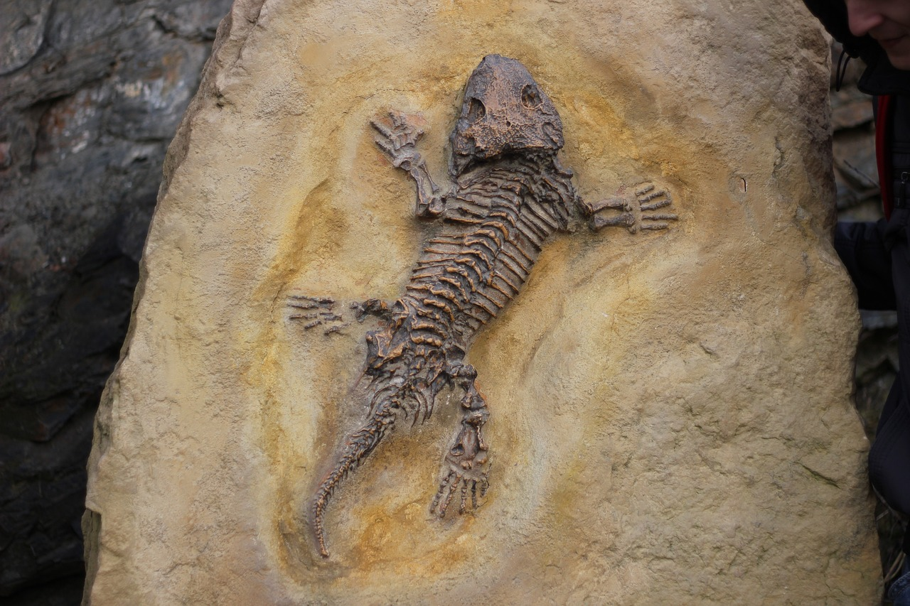
Grade 8 Unit 3: Storyline, Phenomena, and Segments
Storyline Overview
Students make sense of the key disciplinary ideas of natural selection, adaptation, evidence of common ancestry and diversity, inheritance and variation of traits, and history of planet Earth.
Anchor Phenomenon
Measurement Target
Students are able to apply Science and Engineering Practices with emphasis on analyzing and interpreting data to construct and support explanations for patterns in the change of lifeforms in the history of Earth, similarities and differences among organisms, patterns in the cause-and-effect relationships related to inheritance of traits through natural selection, and changes in populations over time.
In this unit, the anchor phenomenon
is based on the shared experience
the class will have of selecting from
an online database of fossils found in their area. Students select a particular organism to think about throughout the unit.
This is a starting point for discussions about the way traits in one animal provide evidence of descent through natural selection over the history of Earth, documented in genetics and the coding of protein by DNA.
Image in the Public Domain at Pixabay.com
Relationship to Prior and Subsequent Learning
Unit 3 engages students in learning about “Understanding Earth History and the Origin of Species” and building knowledge of the history of Earth and the fossil record that is part of that history. This extends to providing evidence for understanding the history of life through evolution and the relationship of previous life forms to those we find today. Students examine evidence for how genetics explains these changes through the effect of DNA mutations on protein structure. This builds on extended ideas related to the Earth’s location and movement within the solar system in Unit 2. Unit 4 focuses on wave behavior, including the transmission of energy through light.
Segment 1
Students develop and use models, obtain, evaluate, and communicate information, construct explanations, and use mathematical and computational thinking to learn about the importance of fossil records and the geological timescale in relation to rock strata and the existence of modern lifeforms.
Segment 2
Students analyze and interpret data, obtain, evaluate, and communicate information, and construct explanations while looking for patterns in various fossil records and relate them to modern life forms.
.
Segment 3
Students obtain, evaluate, and communicate information and develop and use models about the relationships among cells, chromosomes, genes, alleles, and protein structure and function, and how they are affected by gene mutations.
Segment 4
Students analyze information and use mathematical and computational thinking about the role of the environment in affecting the distribution of species according to traits suited for changing environments.
Choose a particular organism from an online database of fossil records around the world.
Obtain and evaluate information about traits to determine relationships in history of species related to their chosen organism.
Investigate the genetic code related to tasting phenylthiocarbamide (PTC).
Obtain and interpret data on changes in the population of a modern-day species over time.
Relate variations in genes, alleles, and chromosomes to evidence about variation in proteins.
Evaluate evidence for the history of Earth in its geologic record.
Analyze data on the impact of the environment on the distribution of traits in a modern-day population.
Analyze and interpret data for the relative age of rocks based on different layers and to explain apparent changes.
Use cladograms and characteristic traits to construct explanations about the historical placement of organisms.
Model the role of mutations on infectious diseases.
Obtain information on the role of the environment on the ancestors and descendants of the chosen organism.
Obtain, evaluate, and communicate information about the impact of genetic mutations on the human species.
Create a model to explain how populations change over time due to natural selection.
Obtain information on the changes in organisms over time and relate it to the geologic record.
Use evidence from incomplete fossil records to identify skeletons of different species.
Use data to create a timeline for the changes in fossils over Earth’s history related to their chosen organism.
Revise model to show how genetic differences contribute to differences in traits from species to species.
Present a final model explaining how surviving individuals lead to emergence of new, stable, and beneficial traits.
Communicate information about evolution and differentiation of species.

