Slide 1
Stackable Instructionally-embedded Portable Science (SIPS) Assessments
A Coherent NGSS- and Framework-aligned System of Science
Curriculum, Instruction, and Assessment
Interpretation Guide
March 2023
The Interpretation Guide for the SIPS Assessment Model: A Coherent NGSS- and Framework-aligned System of Science Curriculum, Instruction, and Assessment was developed with funding from the U.S. Department of Education under the Competitive Grants for State Assessments Program, CFDA 84.368A. The contents of this guide do not represent the policy of the U.S. Department of Education, and no assumption of endorsement by the Federal government should be made.
All rights reserved. Any or all portions of this document may be reproduced and distributed without prior permission, provided the source is cited as: Stackable Instructionally-embedded Portable Science (SIPS) Assessments Project. (2023). Interpretation Guide for the SIPS Assessment Model: A Coherent NGSS- and Framework-aligned System of Science Curriculum, Instruction, and Assessment . Lincoln, NE: Nebraska Department of Education.

Slide 2
The SIPS Model: A Coherent NGSS- and Framework-aligned System of Science Curriculum, Instruction, and Assessment
The Nebraska Department of Education (NDE), in partnership with five other states—Alaska, Alabama, Montana, New York, and Wyoming—as well as several organizations, is leading the Stackable, Instructionally-embedded, Portable Science (SIPS) Assessments project. This project is designed to establish science assessment resources that are coordinated and aligned across all parts of the assessment system.
With coherence as the guiding principle, these state-level educators and national science education and measurement experts have joined with hundreds of local educators to build assessment systems that make sense for students, educators, parents, and other stakeholders who want high-quality teaching and learning models as well as the means for evaluating them.

Slide 3
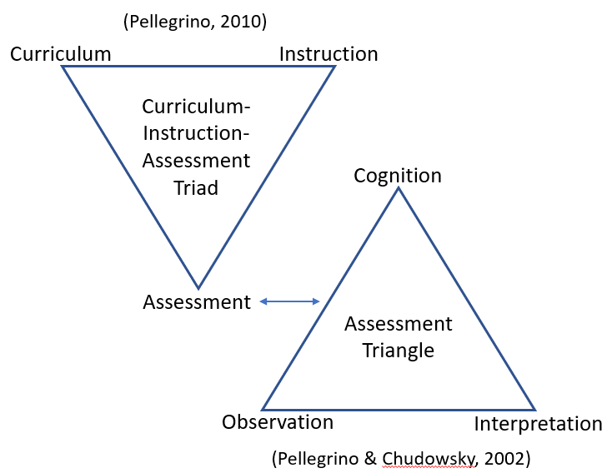
The SIPS project is grounded in both the Curriculum-Assessment-Instruction Triad (CIA; Pellegrino, 2010) and the Assessment Triangle (Pellegrino, Chudowsky, & Glaser, 2001).
The CIA Triad represents necessary connections and balance among our expectations and plans for student learning, how we carry out instruction in classrooms, and how we assess student learning.
The Assessment Triangle illustrates how
assessment of what students know and
can do (cognition) requires appropriate
means for observing students demonstrate
their knowledge and skills as well as
interpretation of those observations in
relation to what we are trying to assess.
These representations
guide SIPS partners’ assessment and curriculum design decisions within the frameworks described on the next page.

Slide 4
SIPS uses design approaches to ensure that curricula and all assessments within an assessment system are fundamentally aligned because they are based upon the same unpacking of the standards and the same definitions of performance and criteria.
Understanding by Design (UbD)
Principled Assessment Design (PAD)
SIPS uses the well-known, three-stage UbD approach to curriculum design (McTighe & Wiggins, 1998) which leverages “backwards planning”: begin with desired results and work backwards to determine the assessment evidence and learning plan necessary to attain those goals. UbD thus provides a deliberate plan for instruction that leads to predetermined goals for what students should know and be able to do at the completion of a unit. The three design stages consider:
SIPS uses an iterative, five-phase PAD approach to assessment design that aligns closely with UbD and to the three-dimensional Next Generation Science Standards derived from the NRC Framework for K-12 Science Education. This disciplined approach draws from evidence-centered design (ECD; Mislevy & Haertel, 2006), a comprehensive approach for assessment design and validation that emphasizes the evidentiary base for specifying coherent, logical relationships among:
learning goals to be targeted (i.e., the knowledge and skills students should acquire
criteria and evidence that will be used to interpret student performance of the targeted learning goals
experiences, lessons, and activities that will best support student learning
learning goals to be measured (i.e., the claims articulating what students know and can do)
evidence in the form of observations, behaviors, or performances that should reveal the targeted learning goals
features of tasks or situations that should
elicit those behaviors
or performances

Slide 5
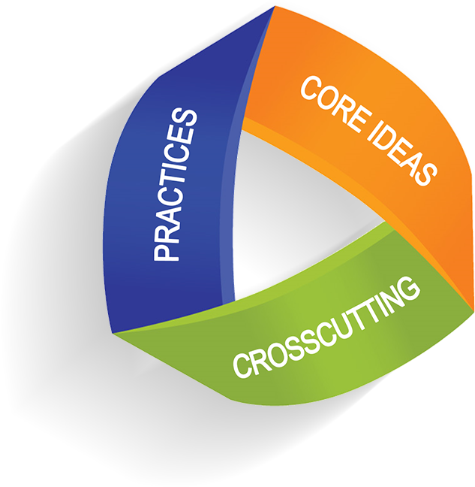
SIPS engaged state and local educators from all 6 partner states in the application of PAD and UbD to
identify meaningful bundles of Next Generation Science Standards (NGSS) performance expectation for grades 5 and 8, and create 4 UbD curriculum maps (i.e., units) to cover those expectations. Each map addresses and includes:
Learning goals to be targeted and measured (i.e., the knowledge and skills students should acquire, including:
Curriculum
Instruction
Experiences, lessons, and activities that can be tailored to support local control and be administered in a way that differentiates and individualizes instruction to support all students’ acquisition of the learning goals, including:
Claims
Performance Expectations Topic Bundles
Measurement Targets
Unit-specific Range Performance Level Descriptors
Unit-specific Student Profile
UbD Stage 1 Learning Goals*
UbD Stage 3 Learning Plan*
UbD Stage 3 Sample Lessons
Differentiation Strategies and Resources to Support Instruction*
To learn more about the process for establishing the SIPS Stage 1 Learning Goals CLICK HERE.
To learn more about the process for developing the SIPS Stage 3 Learning Plan CLICK HERE.
Assessment
Evidence that should reveal and support interpretations of
student performance of the learning goals, and
features of tasks or situations that should elicit those behaviors or performances, including:
End-of-Unit Assessments
UbD Stage 2 Instructionally-embedded Assessments*
UbD Stage 2 Sample Instructionally-embedded Assessments
Formative and EOU Assessment Design Tools
Rubrics and Student Exemplar Responses
To learn more about the process for developing the SIPS Stage 2 Assessments CLICK HERE.
*Included within each unit map (not a standalone resource)

Slide 6
Claim
Principled Design Elements of an NGSS- and Framework-aligned Curriculum, Instruction, & Assessment System
PE Topic Bundle
Unpackings
Measurement Target
Range Performance Level Descriptors
EOU
Design Tools
Design Patterns
Task Specifications
End of Unit Assessment
Scoring Guide
End of Unit Student Profile
Formative Design Tools
Unpackings
Curriculum
Task Specifications
Assessment
Big Ideas*
UbD Stage 1 Learning Goals*
PEs and Dimension Foundation Boxes*
UbD Stage 2 Instructionally-embedded Assessments*
UbD Stage 2 Sample Assessments
UbD Stage 3 Learning Plan*
UbD Stage 3 Sample Lessons
Acquisition Goals*
Essential Questions & Enduring Understandings*
Rubrics and Student Exemplars
Differentiation Strategies & Resources*
Common Core State Standards*
Vocabulary*
Instructional Resources*
(Instructional Sequencing)
Instruction
*Included within each unit map (not a standalone resource)

Slide 7
Curriculum
Curricular Element | Description
Claim | A claim describes what students should know and be able to do in a particular domain such as science. It provides a shared definition of what should be measured and the evidence that should be gathered by assessments to substantiate the claim. Establishing a claim is the first step in designing a system of assessments with the end goals for students in mind.
PE Topic Bundle | A PE Topic Bundle is a group of Next Generation Science Standards (NGSS) performance expectations (PEs) intentionally brought together to facilitate coherent, phenomenon-driven instruction that supports students’ ability to make connections among ideas as they develop a more complete explanation of phenomena. Together, a set of PE Topic Bundles can translate grade-level endpoints into units of instruction that that build all three dimensions of the NGSS over the course of an entire year of instruction.
Measurement Target | A measurement target is a narrative description that integrates the NGSS dimensions (i.e., Disciplinary Core Ideas (DCIs), Science and Engineering Practices (SEPs), and Crosscutting Concepts (CCCs)) into a single statement representing what is to be assessed. The measurement target bridges the gap between the claim and the design of individual assessment tasks.
Range Performance Level Descriptors | Developed for each PE Topic Bundle, range performance level descriptors (PLDs) describe a continuum of less sophisticated to more sophisticated three-dimensional performances of achievement in science across four levels. PLDs support assessment design and evidence-based interpretations of student scores by defining clear expectations about students’ levels of knowledge and skills.
*Included within each unit map (not a standalone resource)

Slide 8
Curriculum
Curricular Element | Description
End of Unit Student Profile | An End-of-Unit Student Profile describes what students should know and be able to demonstrate prior to, during, and at the culmination of an instructional unit. Designed as a key communication and instructional tool for teachers, the profile build educators’ understanding of the targeted student learning outcomes and how they are situated in the context of year-long instruction and to inform the intentional selection of instructional materials and learning opportunities to support student achievement.
UbD Stage 1 Learning Goals* | Stage 1 of UbD involves examining content standards and reviewing learning goals and expectations to articulate what we expect students to know and be able to do in science at the culmination of an instructional unit. Learning priorities are established by long-term performance goals—what it is we want students, in the end, to be able to do with what they have learned and figured out. Thus, the Stage 1 Learning Goals within each unit map focus on the transfer and real-world applicability of science to help students develop and deepen their understanding and application of important ideas, practices, and concepts that support such transfer to new or novel situations or contexts.
Big Ideas* | Big Ideas refer to the DCIs that serve as the focal point of the instructional unit. The Big Ideas are the conceptual priorities that are important for students to know and understand when demonstrating their three-dimensional science learning as they sense-make about science phenomena and phenomena-based design problems. Big Ideas are the basis for defining the Enduring Understandings and Essential Questions students will explore during the unit.
PEs and Dimension Foundation Boxes* | Each unit includes a list of NGSS PEs and dimensions (SEPs, DCIs, and CCCs) that are the focus of instruction and assessment. To ensure that students master all grade-level PEs by the completion of each school year, every PE is covered in at least one unit.
*Included within each unit map (not a standalone resource)

Slide 9
Curriculum
Curricular Element | Description
Acquisition Goals* | Acquisition Goals (AGs) are knowledge-in-use statements that integrate aspects of the NGSS dimensions (SEP & DCI or SEP & DCI & CCC) that are smaller in breadth than a performance expectation. AGs describe the essential concepts and key skills a student must acquire to obtain mastery of the unit’s objectives and emphasize student understanding as rooted in engagement with the practices and not in memorization of science facts. AGs can be of different grain sizes (fine, medium, course) and can address both knowledge and skills across a variety of domains (e.g., science, mathematics, literacy).
CLOSE TRANSFER: The SIPS end-of-unit assessment will elicit evidence of students’ ability to integrate the same dimension combinations as those represented by the PEs and in similar contexts or situations to those explored through instruction (e.g., terrestrial ecosystems).
PROXIMAL TRANSFER: The SIPS end-of-unit assessment will also elicit evidence of students’ ability to flexibly combine the dimensions within the PEs in related but different contexts or situations to those explored through instruction (e.g., terrestrial vs. aquatic ecosystems).
Note: Not all AGs addressed through instruction will be measured by the EOU assessment.
While not measured by the SIPS end-of-unit assessment, proximal transfer is also defined as students’ ability to flexibly combine the dimensions by drawing on SEPs and CCCs from outside of the unit’s PE bundle.
The primary goal of Understanding by Design (UbD) is student understanding: the ability to make meaning of “big ideas” and transfer learning. In science, anchor and investigative phenomena and essential questions are used to engage learners in thoughtful "meaning making" processes to help them develop and deepen their understanding of important ideas, practices, and concepts that support autonomous transfer through authentic performance. As defined by the SIPS project, teaching of the SIPS acquisition goals supports two levels of transfer—close and proximal—in terms of time, place, and context relative to when instruction takes place.
ACQUISITION GOALS SUPPORT TRANSFER
*Included within each unit map (not a standalone resource)

Slide 10
Curriculum
Curricular Element | Description
Essential Questions* | An essential question is an open-ended question that provokes sustained inquiry and meaningful reflection that leads the student to enduring understandings. An essential question requires the student to reflect, ponder, and discuss to arrive at a larger enduring understanding of a concept addressed in the unit. Essential questions may differ in scope and breadth. They can address a skill or topic. Overarching essential questions point beyond the particulars of a unit to the larger skills and understandings. Topical essential questions address the specific disciplinary core ideas in focus for the unit.
Enduring Understandings* | An enduring understanding is a broad conceptual statement that requires time and exploration to uncover or discover the answer. An enduring understanding is not a fact, a list, or a definition, but rather an overarching statement that reflects a deeper internalization of a topic and may connect to a real-life issue or larger understanding of the world for both students and teachers. An enduring understanding reflects an important idea that has lasting value beyond the classroom and should be transferable beyond the scope of a particular unit.
Cross-curricular Integration (Common Core State Standards)* | Cross-curricular Integration addresses the application of relevant knowledge, principles, and/or values to more than one academic discipline (e.g., language arts, mathematics, and science) simultaneously. Boundaries are also provided to delineate prior and advanced knowledge and skills from appropriate grade-level expectations. Opportunities and ideas for cross-curricular integration serve to support instructional goals, such as the transfer of learning and teaching students critical thinking skills, while avoiding fragmented and isolated skill instruction. Each unit map contains a list of the Common Core State Standards for literacy and mathematics that support the cross-curricular focus for the unit.
Vocabulary* | Vocabulary refers to the foundational words and phrases that the student should learn and use during instruction to conceptualize and acquire the stage 1 learning goals.
*Included within each unit map (not a standalone resource)

Slide 11
Assessment
Assessment Element | Description
End-of-Unit (EOU) Assessments | Each EOU assessment is designed to assess the PE bundle at the culmination of the instructional unit. Only the dimensions within the unit bundle are assessed, but they may be assessed in any combination. Each EOU assessment includes three tasks (and approximately 6 to 7 prompts per task) designed to measure students’ ability to flexibly apply knowledge through the integration of the same and new/different combinations of dimensions within the PEs from the unit bundle, in the context of a phenomenon or phenomenon-rooted design problem based on the focal DCIs (see SIPS definitions of close and proximal transfer; slide 9). The EOU assessment results, in combination with evidence from other instructionally-embedded assessments administered throughout instruction, are meant to: (a) support teachers in evidence-driven planning for the next unit, (b) support school and district leaders in monitoring performance, and (c) provide students and teachers with information they can use to support grading.
Stage 2 Instructionally-embedded Assessments* | Stage 2 Instructionally-embedded Assessments enable educators to gather evidence of student learning at specific points in time (e.g., before instruction, during a lesson, after a lesson or series of lessons) throughout the instructional unit. The unit map includes narrative descriptions of these formative assessments that are sequenced and organized into approximately 3 to 4 instructional segments and offer guidance for the development of a wide array of assessments. Each narrative description provides: (a) a summary of the assessment, (b) its intended purpose and use, (c) the evidence of student learning it should elicit, (d) the type(s) of work products (e.g., concept map, model) that will elicit the evidence, and (e) the time needed for administration and scoring. Each unit map also includes 2 to 3 Sample Instructionally-embedded Assessments that serve as illustrative examples of how the narrative descriptions can serve as a roadmap for developing meaningful assessments.
*Included within each unit map (not a standalone resource)

Slide 12
Assessment
Assessment Element | Description
Assessment Design Tools Unpacking Tool Design Pattern Task Specification Tool | An Unpacking Tool provides a clear focus for what is to be measured and helps educators to plan for assessment. Developed for both the EOU and instructionally-embedded assessments, the unpacking tool ensures task designers have a clear and deep understanding of each dimension represented in a PE prior to beginning task development. The Unpacking Tool describes: (a) the underlying key aspects that support each dimension of the PE, (b) the prior knowledge (i.e., background knowledge) that is expected of students, and (c) the relationships between the CCC and SEP. A Design Pattern guides task designers by describing the features of the task necessary to elicit evidence of student proficiency. Developed for the EOU assessments, the Design Pattern includes a “palette” of design features that can be intentionally selected and varied to develop families of tasks aligned to the focal knowledge, skills, and abilities (KSAs) of a performance expectation. The Design Pattern describes: (a) the focal KSAs to be measured, (b) observations (i.e., evidence) to support inferences about students’ acquisition of the KSAs, (c) required features of task situations that elicit the focal KSAs, and (d) variable features of the task that shift complexity or focus. A Task Specification Tool defines key elements needed to be addressed by task designers to develop meaningful and interpretable assessment tasks. Developed for both the EOU and instructionally-embedded assessments, the Task Specification Tool provides information to create prompt(s) that will elicit the necessary evidence for the focal KSAs, such as: (a) a rationale of what the student will do to demonstrate competency, (b) a chain of sensemaking and range of complexity of prompts, (c) allowable stimulus materials and item types, and (d) appropriate vocabulary.
*Included within each unit map (not a standalone resource)

Slide 13
Assessment
Assessment Element | Description
Scoring Rubrics and Student Exemplars (developed for both the SIPS EOU assessments and Instructionally-embedded assessments) | Scoring Rubrics and Student Exemplars are designed to help educators accurately and consistently interpret evidence of student learning from the assessment. Scoring Rubrics include criteria to evaluate the accuracy and completeness of student understanding from low to high levels of competency. Student Exemplars represent high-quality responses that provide evidence that students have demonstrated the knowledge, skills, and abilities assessed by each prompt. Student Exemplars are scientifically accurate, complete, coherent, and consistent with the type of student evidence expected as described in the rubric.
Guidance for Designing Equitable Assessments for Diverse Learners | For each unit, SIPS offers Guidance for Designing Equitable Assessments for Diverse Learners. Based on the three principles of Universal Design for Learning (UDL; CAST, 2022) and elements of Universally Designed Assessments (UDA), this resource offers a multi-step process for promoting the selection and design of equitable assessments to the widest range of students, including, but not limited to, students with varying abilities, cultures, primary languages, background knowledge, and interests. This resources also provides an annotated assessment task that supports understanding and interpreting the features of a well-designed, high-quality assessment task that promotes students’ ability to respond fully and accurately to each prompt or item.
*Included within each unit map (not a standalone resource)

Slide 14
Instruction
Instructional Element | Description
Stage 3 Learning Plan* | The Stage 3 Learning Plan provides narrative descriptions of learning investigations that educators can expand upon to create lessons designed to provide students with opportunities to learn and demonstrate the Stage 1 Learning Goals. Sequenced and organized into 3 to 4 instructional segments, the learning investigations follow an inquiry-based 5E instructional model (Bybee & Landes, 1990) through which students Engage, Explore, Explain, Elaborate, and Evaluate to discover and construct conceptual understanding while sensemaking about rich, authentic phenomena and phenomena-based design problems. Each unit map also includes two Sample Lessons that serve as illustrative examples of how the narrative descriptions can serve as a roadmap for developing meaningful learning opportunities for students.
Core Text Connections* | Each unit contains a list of Core Text Connections which can include research publications, articles, data sources, or other texts in a variety of modes and formats that support instruction for the unit.
Instructional Resources* | Each unit contains a list of Instructional Resources that support both teachers and students. These resources include websites, background information on the subject-area, strategies and tips for delivering instruction, lessons, graphic organizers, etc.
Differentiation Strategies and Resources for Diverse Learners | Each unit provides Differentiation Strategies and Resources for Diverse Learners for each Universal Design for Learning principle—Multiple Means of Engagement, Multiple Means of Representation, and Multiple Means of Action & Expression—to support the design and delivery of accessible instruction and learning opportunities to the widest range of students. By examining instruction and instructional materials through the lens of each of these principles, educators can identify and reduce or remove barriers to diverse learners.
*Included within each unit map (not a standalone resource)

Slide 15
References
Bybee, R., & Landes, N. M. (1990). Science for life and living: An elementary school science program from Biological Sciences Improvement Study (BSCS). The American Biology Teacher, 52(2), 92-98.
National Center on Universal Design for Learning, at CAST. (2012). Resources available at http://www.udlcenter.org
McTighe, J. & Wiggins, G. (1998). Understanding by Design. Alexandria, VA: Association for Supervision and Curriculum Development (ASCD).
Mislevy, R. J., & Haertel, G. D. (2006). Implications of evidence-centered design for educational testing. Educational Measurement: Issues and Practice, 25(4), 6–20.
Pellegrino, J. W., Chudowsky, N., & Glaser, R. (2001). Knowing what students know: The science and design of educational assessment. Washington, DC: National Academy Press.
Pellegrino, J.W. (2010). The Design of an Assessment System for the Race to the Top: A Learning Sciences Perspective on Issues of Growth and Measurement. In P. Forgione & N. Doorey (Eds.), Exploratory Seminar: Measurement Challenges Within the Race to the Top Agenda. Princeton, NJ: Center for K-12 Assessment & Performance Management, Educational Testing Service.

Slide 16
For more information, contact:
Ellen Forte, Ph.D.
SIPS Co-principal Investigator
CEO & Chief Scientist
edCount, LLC
eforte@edCount.com
Erin Buchanan
SIPS Project Director
Senior Associate
edCount, LLC
ebuchanan@edCount.com

