Slide 1
Stackable Instructionally-embedded Portable Science (SIPS) Assessments
Grade 5 Unit 4
Earth and its Gravitational Force and Motion
Storyline Overview
September 2023
The Grade 5 Unit 4 Earth and its Gravitational Force and Motion: Storyline Overview was developed with funding from the U.S. Department of Education under the Competitive Grants for State Assessments Program, CFDA 84.368A. The contents of this guide do not represent the policy of the U.S. Department of Education, and no assumption of endorsement by the Federal government should be made.
All rights reserved. Any or all portions of this document may be reproduced and distributed without prior permission, provided the source is cited as: Stackable Instructionally-embedded Portable Science (SIPS) Assessments Project. (2023). Grade 5 Unit 4 Earth and its Gravitational Force and Motion: Storyline Overview. Lincoln, NE: Nebraska Department of Education.

Slide 2
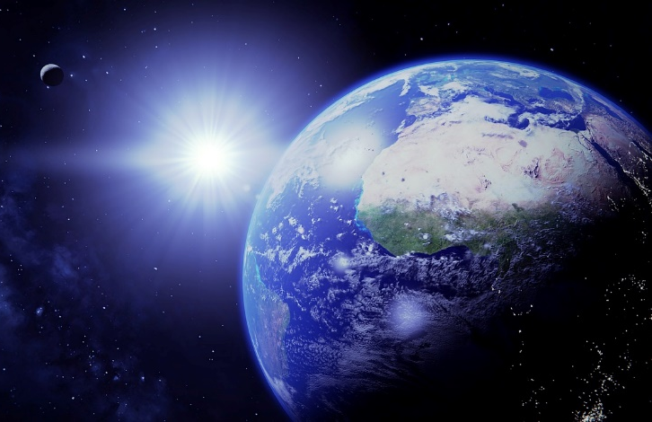
Grade 5 Unit 4: Storyline, Phenomena, and Segments
Storyline Overview
Students make sense of the key disciplinary ideas of the direction of Earth’s gravitational forces and how distance from the Earth influences the brightness of the sun and stars.
Anchor Phenomenon
Measurement Target
Students are able to apply Scientific and Engineering Practices with emphasis on supporting an argument using data represented in graphical displays related to the scale of the universe relative to Earth and daily and seasonal patterns of observed physical phenomena on Earth both as a result of its place in the solar system and the effects of gravitational forces.
In this unit, the anchor phenomenon is centered around observations of what is in the sky. This phenomenon engages students with astronomical studies of Indigenous cultures from around the world to encourage students to consider how different cultures engage with astronomy and the stars. Students generate and investigate questions about constellations, the sun, and the stars’ apparent motion through the sky.
Relationship to Prior and Subsequent Learning
Unit 4 engages students in learning about “Earth and its Gravitational Force and Motion” and in building on prior knowledge to use and extend their understanding to characterize how daily observable patterns on Earth’s surface is a result of the gravitational force and rotation of the planetary objects. In Unit 3 students use the practices of developing and using models, analyzing and interpreting data, and using mathematics and computational thinking and defining solutions to a problem and the crosscutting concepts of scale proportion and quantity. In Unit 4 they again use these same practices and crosscutting concepts to build their understanding of gravitational forces and their influence on the daily and seasonal patterns of physical phenomenon observed on Earth.
Segment 1
Students analyze data, develop models, and engage in arguments based on evidence to learn about size, brightness, and distance of stars in the sky. Students start with observing what is seen in the sky as seen in media, stories they have heard, and their actual surroundings.
Segment 2
Students develop and use models, interpret data, and engage in arguments based on evidence to learn about the pull and direction of Earth’s gravitational force, how weights of objects are related, and to explore the spherical shape of planetary objects.
Segment 3
Students develop and use models, analyze and interpret data, construct explanations, and engage in argument from evidence for deeper understanding of the movement and patterns of Earth’s rotation and revolution, causes of day/night, and effects on shadows.
Segment 4
Students develop and use models, analyze and interpret data, and engage in argument based on evidence to compare lengths of days of different locations on Earth and determine why some constellations are visible at a location only during certain times of the year.
Ask questions about how constellations are viewed in the sky.
Analyze data on the shapes of objects in the solar system.
Investigate and develop a model on the apparent motion of the sun, stars, and moon.
Apply their model of the Earth’s motions to explain the night sky.
Investigate resources to learn about the nature of different stars.
Develop a model that displays the motion of falling objects.
Investigate the length and direction of shadows and their relation to the sun’s position.
Investigate the relative position of constellations during different times of the year.
Investigate the direction of gravitational force with different objects and in different places.
Investigate how the apparent size and brightness of an object depends on actual size and distance.
Obtain and communicate information on time zones and their relation to the position of the sun and Earth.
Analyze data on the changes in the time and position of sunrise and sunset during the year.
Use a model of gravity to develop an explanation for why planetary objects are round.
Analyze and interpret data on the relation of brightness of lights at different distances.
Revise and use a model of the Earth’s motion relative to the stars.
Refine a model to include variations in the time and position of sunrise and sunset as the Earth rotates and revolves around the sun.
Develop an argument based on evidence for the Earth’s spherical shape.
Investigate how very bright objects can impact what we can see of dimmer objects.
Collect and analyze data modeling weight on different planets.
Build a sundial to investigate shadows and the movement of the sun
Create a model of the Earth relative to the stars.

